Slide 1
Section 5 – Sprooky the Rocket

Slide 2
Game Screen
B
Moving obstacles
A
Left
Right
Boost

Slide 3
Project Boost Game Design
Player Experience:
Precision. Skilful.
Core Mechanic:
Skilfully fly spaceship and avoid environmental hazards.
Core game loop:
Get from A to B to complete the level, then progress to the next level.

Slide 4
Game Flow And Screens
Level 1
If succeed
Level 2
If die
Level X

Slide 5
Game Theme (ie. Story & Visuals)
Experimental early generation spacecraft.
On an unknown planet, trying to escape.

Slide 6
What’s Your Theme?
Think of a central theme for your game.
Decide on a starting name for your game.

Slide 7
Onion Design

Slide 8
Common Development Questions
What features should I include in my game?
Where should I start development?
What are my priorities?
What if I run out of time?
When should I stop?

Slide 9
Onion Design
Most important feature
All features need to feed the core and make it better
2nd most important feature
Core Feature
3rd most important feature

Slide 10
Game Screen
999
Fuel
B
Shooting
Moving obstacles
A
Power Ups
Left
Right
Boost

Slide 11
Sketch Our Onion Design
What do you believe is the single most important feature of our game?
What is next most important?

Slide 12
Onion Design For Project Boost
Movement / flying
2. World collision
Core Feature
3. Level progression

Slide 13
Building Our Starting Pieces
Rocket
Launch Pad
Landing Pad
Ground

Slide 14
Which Axis Is Which...
+x = right
+y = up
+z = forward

Slide 15
Build Our Starting Pieces
Create the items from just 1 primitive each (later we’ll make them more complex if need be):
Ground
Launch pad
Landing pad
Rocket

Slide 16
Basic Input Binding

Slide 17
Finish Our Code
Replace the “somethings” with code
When we push “A” then print “rotate left”
When we push “D” then print “rotate right”
BONUS:
Identify the bug / issue with our logic

Slide 18
Using AddRelativeForce()

Slide 19
Tuning Our Rocket
Add a variable so we can tune the main rocket thrust
Make the force applied frame rate independent

Slide 20
Transform.Rotate() Our Rocket

Slide 21
Tuning Our Rocket’s Rotation
Add a variable so we can tune the rotation speed
Make the rotation speed frame rate independent

Slide 22
Rigidbody Constraints

Slide 23
Tidy Up Our Movement
Apply changes to prefab
Add an obstacle
Freeze constraints for our rocket
Fix our obstacle-hitting bug
Set our drag value

Slide 24
Unity Audio Introduction

Slide 25
3 Main Things We Need
Audio Listener
The “sounds” that get played
Audio Source
To “hear” the audio
Audio File
To “play” the audio

Slide 26
Linking Components To Assets
Game Object
Audio Source Component
We can add a reference to our audio file directly into the Audio Source component
Assets On Disk
SoundEffect.ogg

Slide 27
Play AudioSource SFX

Slide 28
Play SFX When Thrusting
Cache a reference to AudioSource called audioSource
Use audioSource.Play() to play when we are thrusting
Use !audioSource.isPlaying to make sure we only play if we aren’t already playing (Note: ! = not true)
Use an else condition and audioSource.Stop() to stop our SFX when we aren’t thrusting.

Slide 29
Respawn Using SceneManager

Slide 30
Reload Current Scene
Use SceneManager.LoadScene() to load the current scene and therefore respawn our rocket ship when it collides with the ground
You’ll need to use the UnityEngine.SceneManagement namespace

Slide 31
Load Next Level

Slide 32
Load Next Level
When we reach the Landing Pad, load the next level.
Hint: our scene index is an integer, therefore we can add a number to it.

Slide 33
Using Invoke

Slide 34
Using Invoke
Using Invoke() allows us to call a method so it executes after a delay of x seconds.
Syntax:
Invoke(“MethodName”, delayInSeconds);
Pros: Quick and easy to use
Cons: String reference; not as performant as using a Coroutine

Slide 35
Use Invoke To Delay Next Level
Parameterise our delay (ie. make a variable which we can tune in the inspector)
When we reach the Landing Pad, make sure we have a delay before loading the next level
Stop player controls during the delay

Slide 36
Multiple Audio Clips

Slide 37
Play Audio On Collision
Trigger for audio to be played for these situations:
When the player crashes into an obstacle
When the player successfully reaches landing pad
HINTS:
Get and cache the audio component
Create variables for each clip
Play the clip at the appropriate time

Slide 38
Bool Variable For State

Slide 39
Finish Our Logic
We want to stop additional things happening after we have a collision event.
Use our isTransitioning bool and an if statement.

Slide 40
Make Rocket Look Spiffy

Slide 41
Make Your Rocket Look Different
Using basic shapes, update your rocket prefab to look interesting.
Add a splash of colour.
Consider the pivot point so that the rotation feels right.

Slide 42
How To Trigger Particles

Slide 43
Particles System Component
Particle System is a Component added to a Game Object
Particles
We use Modules for controlling behaviour
Each particle is not a Game Object
Emitter

Slide 44
Play The Particle Effect
We use ParticleSystem.Play() to play our particle system when triggered...
When we crash, play the explosion particles
When we reach landing pad, play success particles

Slide 45
Particles For Rocket Boosters

Slide 46
Get Ourselves Ready To Trigger
Set up your rocket so that it has 3 particle systems, ready for us to trigger in code:
Main booster
Left booster
Right booster
Add them in your prefab and create variables for each

Slide 47
Refactor With Extract Method

Slide 48
Tidy Up Our Code
Using the extract method approach, refactor ProcessThrust() and ProcessRotation() to make them read as clearly as possible.

Slide 49
Make Environment

Slide 50
Make Your Levels Look Interesting
Using the provided assets, add some depth to the look of your level.
Try to frame your world so the player can’t fly off where they shouldn’t.

Slide 51
How To Add Lights In Unity

Slide 52
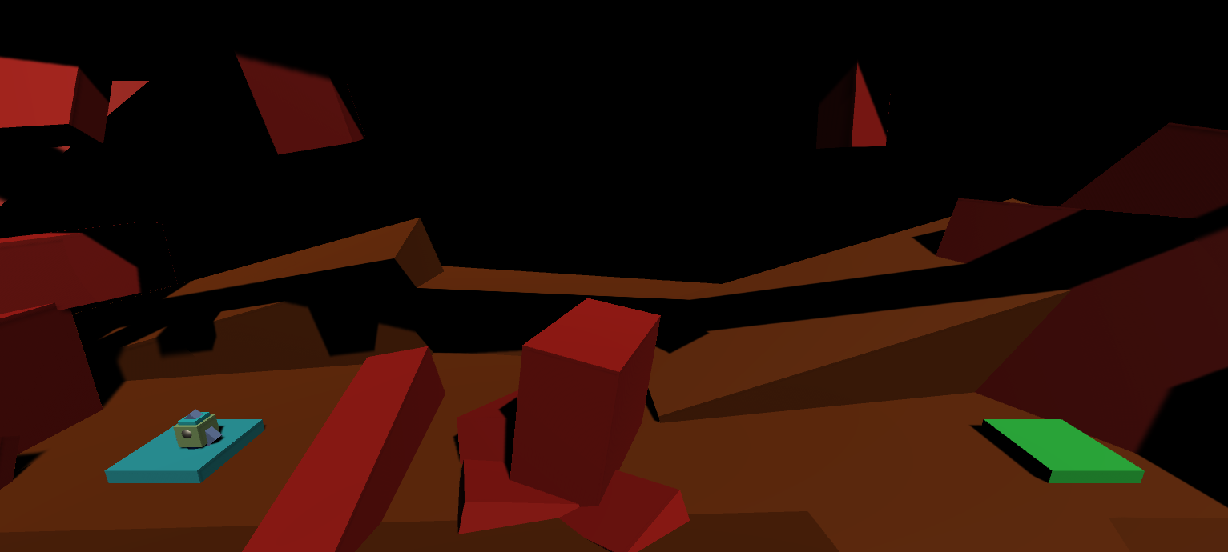
Main Directional Light (Sun)
Environment Lighting
Scene Lights

Slide 53
Light Your Scene
Add at least one point light and one spotlight to your scene.
Experiment with a lighting setup that you’re happy with.

Slide 54
Move Obstacle With Code

Slide 55
To Move In A Consistent Direction
Starting position (x, y, z)
Movement Vector
(x, y, z)

Slide 56
To Move In A Consistent Direction
Starting position (0, 0, 0)
Movement Vector
(10, 0, 0)
Move 10 on x axis

Slide 57
To Oscillate (Back & Forth)
Starting position (0, 0, 0)
Movement Vector
(10, 0, 0)
0
Movement Factor
(between 0 and 1)
1

Slide 58
To Oscillate (Back & Forth)
Eg. Movement Factor
is currently 0.5, Offset is?...
Starting position (0, 0, 0)
Offset =
5, 0, 0
Movement Vector
(10, 0, 0)
*
0
Movement Factor
(between 0 and 1)
1

Slide 59
Finish The Last Line
Add one more line that defines the new position of the object that is offset from its original position.

Slide 60
Mathf.Sin() For Oscillation

Slide 61
Make Something Move
Oscillate something in your level so that it provides an interesting challenge for your player.

Slide 62
Protect Against NaN Error

Slide 63
Try And Protect Zero Period
Try and put some protection code in.
The goal is to eliminate the NaN error when period is 0.

Slide 64
Notes About Comparing floats
Two floats can vary by a tiny amount.
It’s unpredictable to use == with floats.
Always specify the acceptable difference.
The smallest float is Mathf.Epsilon
Always compare to this rather than zero.
For example...
if (period <= Mathf.Epsilon) { return; }

Slide 65
Designing Level Moments

Slide 66
Useful Game Design Approach
Design “moments” and then expand them into a level. Moments that use the environment:
Fly under
Fly over
Fly through a gap
Time your flight through moving obstacle
Land on moving platform
Fly through narrow tunnel

Slide 67
Useful Game Design Approach
Moments that use tuning of our existing game:
Slower rocket (eg. it got damaged)
Faster rocket (eg. got a boost)
Darker level
Closer camera
Bigger rocket (carrying something)
Reversed controls
And so on...

Slide 68
Level Design Challenge (If Interested)
Create 5 (or more) different levels, each with a unique game moment
Add the levels to the build settings so they are playable
Share a video with us of your one best moment (OBS is a free recording package)

Slide 69
Quit Application

Slide 70
Hit Escape To Quit
Create a new script called QuitApplication.cs
Create logic so that if the player hits escape on their keyboard we call Application.Quit()
Add a debug line to make sure that hitting escape works.

Slide 71
How To Build & Publish A Game

Slide 72
Tips & Tricks

Slide 73
The Origin Of Our World

Slide 74
Which Axis Is Which...
+x = right
+y = up
+z = forward

Slide 75
Setup Your World
Your ground level is at y = 0.
The launchpad is centered on x = 0, z = 0.
You have an initial camera view you like.
Everything in the Hierarchy is “prefabbed”.
You have assigned terrain colour.
You’ve modified the directional light rotation.

Slide 76
Placeholder Art From Primitives

Slide 77
Setting-up Compound Objects
Keep mesh away from top-level so easy to swap.
Keep top-level object scale close to (1,1,1).
Beware of Pivot / Centre option (Z key).
Check object rotates, scales and instantiates ok.

Slide 78
Your Version 1 Ship Is… Shipped
You have an INITIAL ship you’re happy with.
It’s obvious which way is up.
It has a splash of colour on it.
It rotates around what looks like it’s centre.
It should have a prefab, and z is into background.
Drag prefab to Hierarchy puts rocket on launchpad.

Slide 79
Basic Input Binding

Slide 80
Create Rotation Keys
Pushing A should repeatedly print “Rotating left”.
Pushing D should do the same for right.
You should be able to thrust AND rotate.
You should not be able to rotate both ways at the same time.

Slide 81
Physics and Rigidbodies

Slide 82
Using GetComponent<>()
Use the following template to create a rigidBody member variable in your code, which allows you to access the rigid body on the same game object…
rigidBody = GetComponent<RigidBody>();
… pay particular attention to capitalisation.

Slide 83
Hover Your Ship
The mass should be just right to hover.
You should be able to land back on pad.

Slide 84
Coordinate System Handedness

Slide 85

Unity Uses A Left-Handed System

Slide 86
Try Labelling Your Fingers!
You should understand the difference in the systems between right and left hand.
Remember to label your fingers in a circular way, but it doesn’t matter where you start.

Slide 87
Using Time.deltaTime

Slide 88
Frame-rate Independence
The time each frame takes can vary wildly.
Time.deltaTime tells you the last frame time.
This is a good predictor of the current frame time.
We can use this to adjust our movement.
Longer frames lead to more movement.
Shorter frames lead to less movement.
e.g. rotation = rcsThrust * Time.deltaTime;

Slide 89
Words For Parts Of A Transform
 | As A Noun | As A Verb | Code Example
Transform | Position | Translate | transform.Translate();
 | Rotation | Rotate | transform.Rotate();
 | Scale | Scale | transform.localScale;

Slide 90
Adding A Touch Of Audio

Slide 91
Linking Components To Assets
Game Object
Audio Source Component
Assets On Disk
SoundEffect.ogg

Slide 92
Start And Stop Audio
The audio should start when you thrust.
It should stop immediately you stop thrusting.
There should be no weird audio artifacts.

Slide 93
Resolving Movement Bugs

Slide 94
Your Movement Is Bug Free
You can move from one platform to another.
A platform can induce spin but it stops on thrust.
You have Drag value you’re happy with.
Your code is beautiful.

Slide 95
Using [SerializeField] vs public

Slide 96
Multiplying Vectors
Multiply a vector by a float.
You end-up with a new vector.
New vector is parallel.
It’s a different length.
Works for rotation and translation.
Vector3.up * 2
Vector3.up

Slide 97
Exposing Member Variables
Modifier | Change In Inspector? | Change From Other Scripts?
[SerializeField] | Yes | No
public | Yes | Yes

Slide 98
Serialise mainThrust
Main Thrust should be adjustable in the inspector.
The ship’s Rigid Body component should be reset.
The ship should handle similarly to before.
Enjoy fooling around with your ship!

Slide 99
Tagging Game Objects As Friendly

Slide 100
Pros and Cons of Tags
Pros | Cons
Just one per game object | Is based on a string
Very simple to use in Inspector | Have to rename in 2 places
Makes for clear code | Nothing “keeps you honest”

Slide 101
Write Collision Logic
Your collisions should log either “dead” or “OK”.
Allow for future tags (e.g. Fuel).
opt-in to Friendly tag.

Slide 102
Basic Level Design

Slide 103
Designing Our First Level
Levels are a series of interesting moments.
Always refer back to your game design intention for Player Experience.
Our is: “Skilled rocket pilot”
There is an ongoing tension between gameplay tuning and level tuning.

Slide 104
Create An Interesting Moment
Refine your camera if need be.
Place start, finish and obstacles to create an interesting moment.
Playtesting and refine.

Slide 105
Design Levels And Variation

Slide 106
As Indie Developers...
Try to use what we have to make new / different / better gameplay before adding features.
What are our current design levers?
Rotation, thrust, gravity, size, level layout, lighting, friendly / unfriendly, camera, goal...
When prototyping, go to the extremes.

Slide 107
Prototype Something Fresh
Pull your design levers to create something different to us.
Remember to commit to your repo beforehand, in case you need to revert!

Slide 108
Making A Second Level

Slide 109
Some Options For Multiple Levels
Create a new Unity scene for each level
Place all the levels in one scene and retarget the camera
Stitch the levels one after another and use a scrolling camera

Slide 110
Create A Second Level
Duplicate your scene.
Create a new level based upon a different type of moment.

Slide 111
Prefabs In Detail

Slide 112
Create Object
Prefab & Save Scene
Position & Rotation
All other details
.unity scene file
Position & Rotation
All other details
New .prefab file

Slide 113
Explore Prefabs
Create a sandbox scene.
Explore prefabs until you feel you “get it”.
Duplicate Launch Pad, prefab it to Landing Pad and tag as “finish”.

Slide 114
Level Loading & Scene Management

Slide 115
Your Game Cycles Through 2 Levels
Level 1
If die
Level 2

Slide 116
Invoke() As A Coroutine Warm-up

Slide 117
Delaying Level Load
Alive
Dying or Transcending
Timer Expired?
Remember other messages still arrive while waiting for timer

Slide 118
Delay Level Load On Death
The first level should still load when you die.
There should be a delay before it does so.
Player controls should be disabled while dying.
Create a new method.

Slide 119
Playing Multiple Audio Clips

Slide 120
An Alternative Way Of Playing Audio
Still have an audio source.
No need to have a default clip.
Specify the clips as [SerializeField] “levers”.
Use audioSource.PlayOneShot(clipName);

Slide 121
Setup Your Sounds
Your death should have a unique sound.
Your level load should have a cool sound.
Thrust sound should stop playing in either case.
Your level should feel coherent and complete.

Slide 122
Introducing Particle Effects

Slide 123
Particle Systems Guidelines
Use a separate game object for particle system.
Consider disabling “Play On Awake”
[SerializeField] ParticleSystem name;
Trigger using name.Play();
ENJOY the visual carnage!

Slide 124
Trigger Particles On Death
There should be a spectacle on death.
Your code should be super clean.
Audio should still work fine.

Slide 125
Moving Platform Pattern

Slide 126
Manually Moving Platforms
[SerializeField] Vector3 movementVector;
[Range(0, 1)] [SerializeField] float movementFactor;
Vector3 startingPos; // must be stored for absolute movement
void Start()
{
startingPos = transform.position;
}
void Update()
{
Vector3 offset = movementVector * movementFactor;
transform.position = startingPos + offset;
}
Notes:
We multiply vectors in [SerializeField] vs public lectures

Slide 127
Make It Shake!
At least one obstacle should oscillate manually.
You should feel comfortable with how it works.
Enjoy your new creative tool!

Slide 128
Mathf.Sin() For Movement Cycles

Slide 129
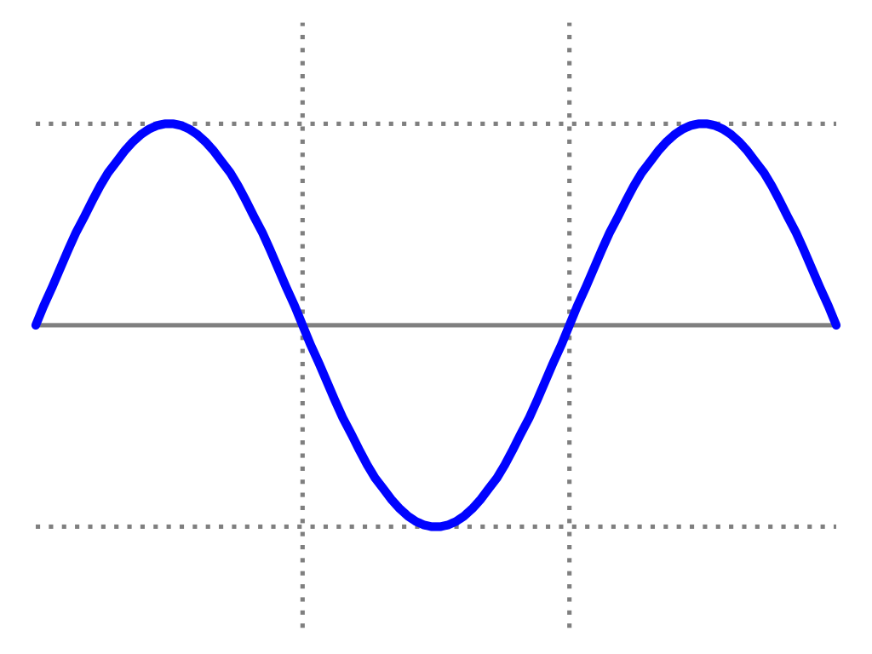
amplitude (m)
period (s)

Slide 130
Setup An Oscillator
Setup at least one game object to oscillate.
Have fun!

Slide 131
Notes About Comparing floats
Two floats can vary by a tiny amount.
It’s unpredictable to use == with floats.
Always specify the acceptable difference.
The smallest float is Mathf.Epsilon
Always compare to this rather than zero.
For example...
if (period <= Mathf.Epsilon) { return; }

Slide 132
Organising Your Assets
Create folders.
Use search by type.
Create Favourites for Searches.
Rearrange window layout / save layouts.

Slide 133
Organise Your Assets
Create a folder structure that works for you.
Tidy up your scene assets.
Make sure your prefabs are correctly linked.

Slide 134
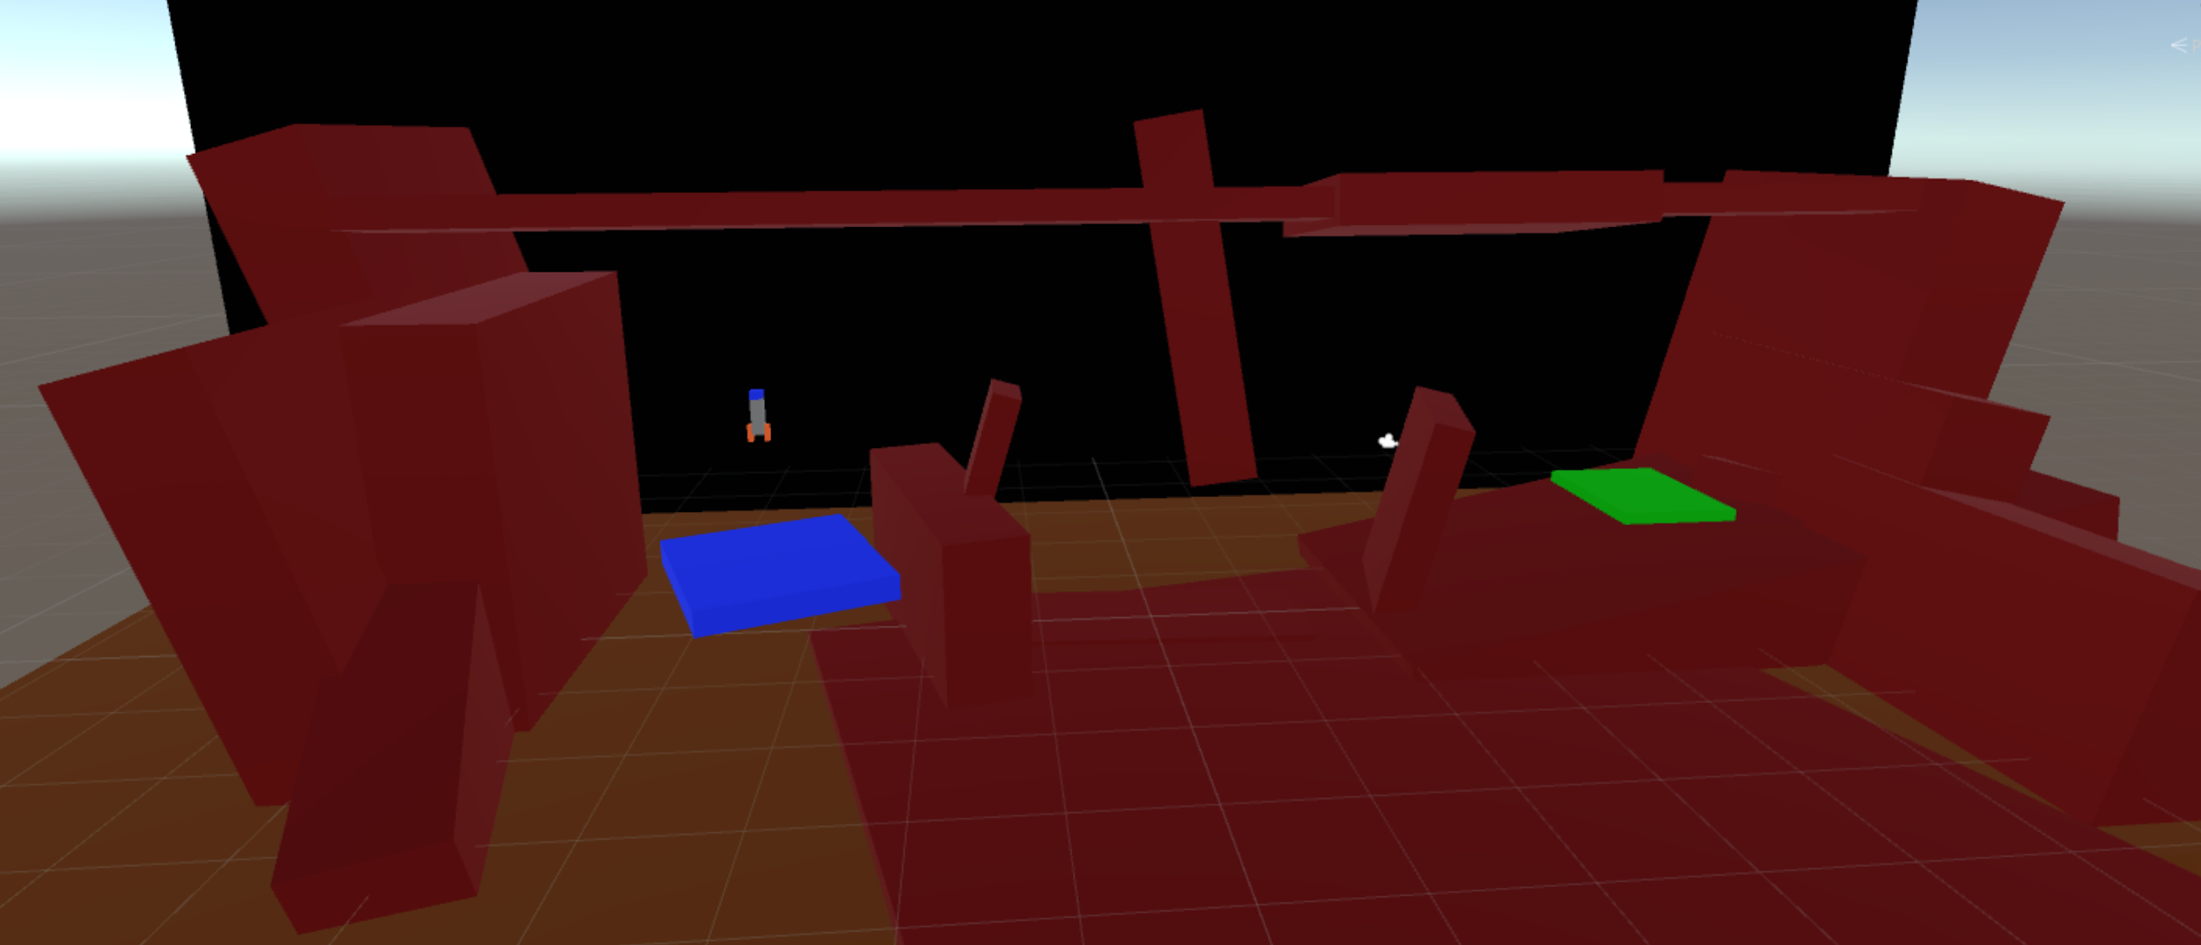
Main Directional Light (Sun)
Environment Lighting
Scene Lights

Slide 135
Add Scene Lighting
Alter your scene’s main directional light to make your scene feel different.
Add at least one scene light.

Slide 136
Figure Out The Nested Prefab Rules
A different sort of challenge!
Using our Rocket Ship as the parent, figure out the relationship / dependency between the child Success Particle Effect and the Success Particle Effect prefab.

Slide 137
Childing A Prefab To A Prefab
The moment we child Particle Effect to Rocket
Original Particle Effect
Where is the “Source of Truth”?
Particle Effect Data on Rocket
Particle Effect Data on Prefab

Slide 138
Where Is The Data?
Scene
Copying GOs? Then...
Prefab
Copying Prefabs? Then...
Instantiate at runtime

Slide 139
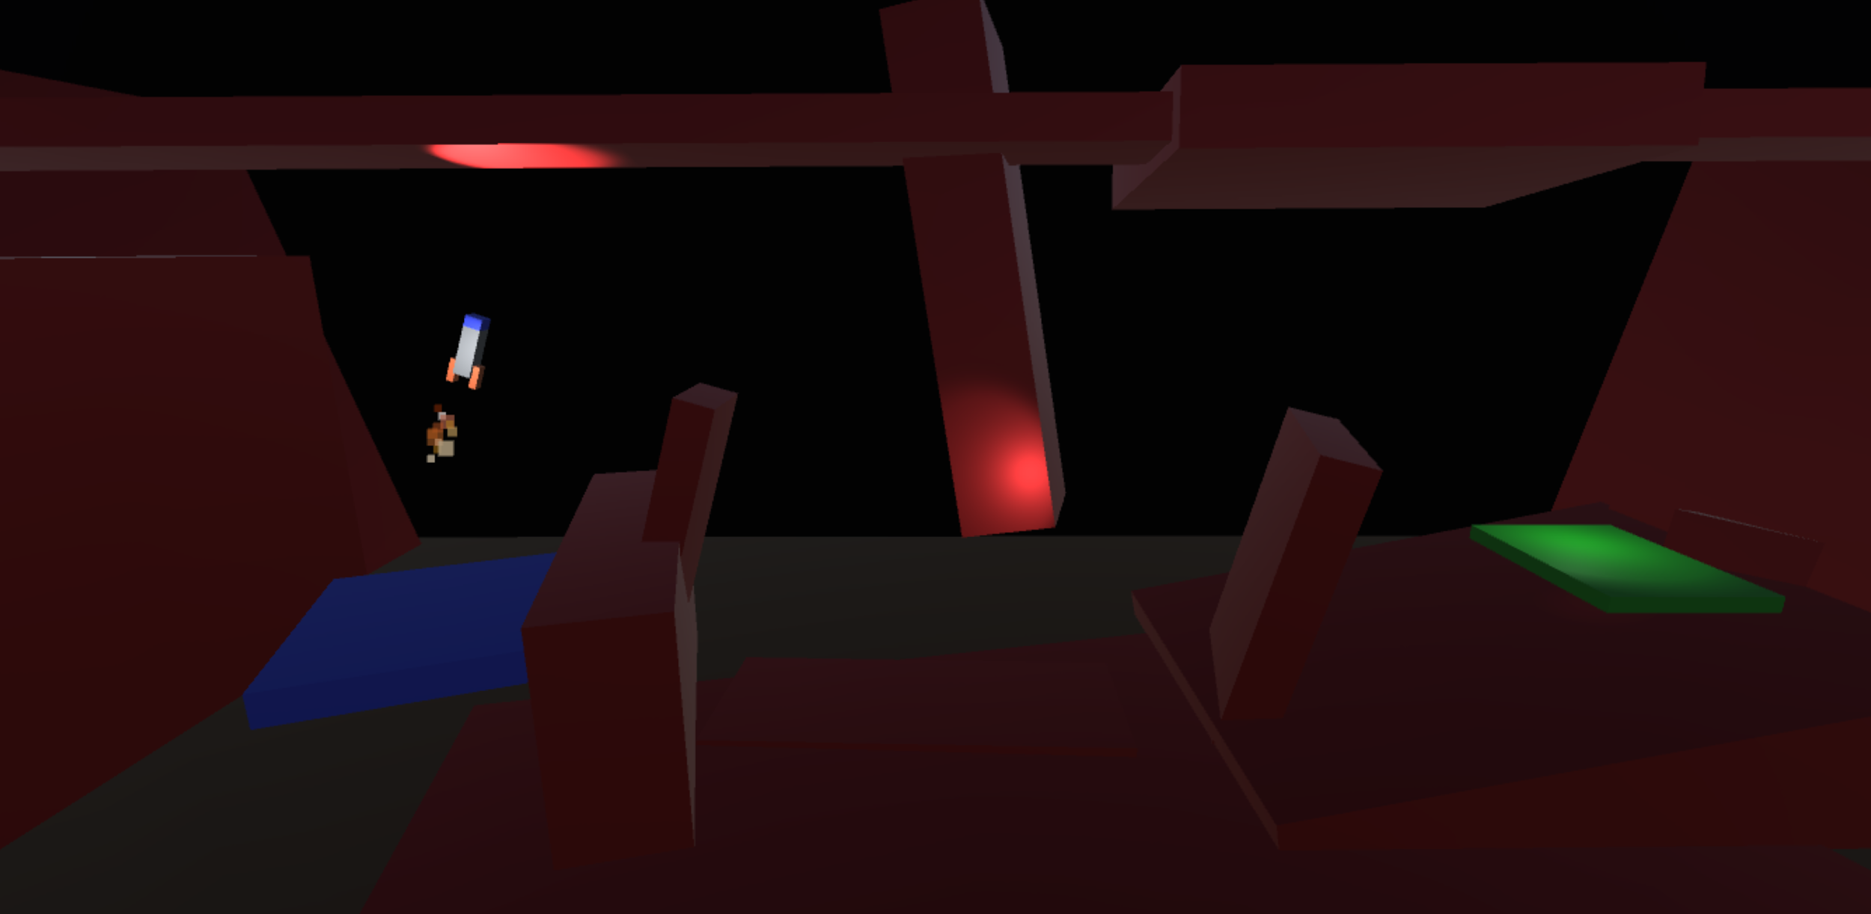
Levels:
Layout
Moving Objects
Flow / Progression
Audio:
Player Movement
Explosion, Success
Ambiance
Tuning:
Player Movement
Camera Position
Timing (eg. level load)
Visuals:
Lighting
Particle Effects
Materials / Colours

Slide 140
Level Flow And Variety
We need to keep our players engaged for as long as we can
Two options with our current game:
Randomised levels of similar challenge level
Sequential levels of increasing challenge level

Slide 141
Looping Through Levels

Slide 142
A Temporary Limitation
New rocket created on each level load
Any member variables are reset
So can’t store number of levels won on rocket
Simply use a conditional for last level.

Slide 143
Get The Levels Cycling
Your game should loop around all levels in the current build order.
When you get to the last level return to the first.

